Slide 1
Power BI REST API with Power Query optics
„Make your data shine!“
2022

Slide 2







SPEAKER
ŠTĚPÁN REŠL
Zkušenosti VBA programování Power Platform konzultant
Power BI konzultant
Power BI školitel
Power BI mentor
Zkušenosti Business analýza
Project management
Power Platform Lead
Portfolio management
COO

Slide 3
AGENDA - What is Rest API - How it can help me - Access token? Why & How - IDs & Secrets - Production time

Slide 4
WHAT IS REST API

Slide 5







REST API
VILLAGE
RESTAURANT
MENU
CASH REGISTER
MEAL
GET LIST OF MEALS
GET MEAL
DRINKS
GET LIST OF DRINKS
GET DRINK
PAYMENT
GET BILL
POST PAYMENT
POST FEEDBACK
WAITTING FOR ORDERS
CHEF
WAITTING FOR ORDERS
HI! I AM API. I WOULD LIKE TO WELCOME YOU TO OUR REST(AURANT)!
CUSTOMER

Slide 6
REST API
VILLAGE
RESTAURANT
MENU
CASH REGISTER
MEAL
GET LIST OF MEALS
GET MEAL
DRINKS
GET LIST OF DRINKS
GET DRINK
PAYMENT
GET BILL
POST PAYMENT
POST FEEDBACK
WAITTING FOR ORDERS
CHEF
WAITTING FOR ORDERS
CUSTOMER

Slide 7

REST API
VILLAGE
RESTAURANT
MENU
CASH REGISTER
SORRY BUT YOU HAVE TO SPECIFY WHAT MEAL YOU WOULD LIKE TO
MEALS
GET LIST OF MEALS
GET MEAL
DRINKS
GET LIST OF DRINKS
GET DRINK
PAYMENT
GET BILL
POST PAYMENT
POST FEEDBACK
WAITTING FOR ORDERS
X
CHEF
WAITTING FOR ORDERS
CUSTOMER

Slide 8
REST API
VILLAGE
RESTAURANT
MENU
CASH REGISTER
WHAT DO WE HAVE ON TODAYS MENU?
MEALS
GET LIST OF MEALS
GET MEAL
DRINKS
GET LIST OF DRINKS
GET DRINK
PAYMENT
GET BILL
POST PAYMENT
POST FEEDBACK
WAITTING FOR ORDERS
CHEF
CONTENT: LIST OF MEALS
LIST OF MEALS
BURGER
PIZZA
RIZZOTO
CUSTOMER

Slide 9

REST API
VILLAGE
RESTAURANT
MENU
CASH REGISTER
MEALS
GET LIST OF MEALS
GET MEAL (RIZZOTO)
DRINKS
GET LIST OF DRINKS
GET DRINK
PAYMENT
GET BILL
POST PAYMENT
POST FEEDBACK
WAITTING FOR ORDERS
CHEF
CONTENT: RIZZOTO
RIZZOTO
… preparing …
… preparing …
… preparing …
DONE
CUSTOMER

Slide 10

REST API
VILLAGE
RESTAURANT
MENU
CASH REGISTER
MEALS
GET LIST OF MEALS
GET MEAL
DRINKS
GET LIST OF DRINKS
GET DRINK
PAYMENT
GET BILL
POST PAYMENT
POST FEEDBACK
BILL
** GENERATING **
** GENERATING **
DONE
CONTENT: BILLED AMOUNT
CHEF
WAITTING FOR ORDERS
CUSTOMER

Slide 11
REST API
VILLAGE
RESTAURANT
MENU
CASH REGISTER
MEAL
GET LIST OF MEALS
GET MEAL
DRINKS
GET LIST OF DRINKS
GET DRINK
PAYMENT
GET BILL
POST PAYMENT
POST FEEDBACK
PAYMENT ** CHECKING AMMOUNT **
** BALANCE = 0 ** ** TRANSACTION DONE **
DONE
CONTENT: AMOUNT
CHEF
WAITTING FOR ORDERS
CUSTOMER

Slide 12



REST API
GET
POST
HTTP REQUEST
PUT
HTTP RESPONSE
DELETE
*PATCH
JSON | XML | HTML

Slide 13
HOW IT CAN HELP ME

Slide 14










HOW IT CAN HELP ME
GET| POST | PUT | UPDATE | DELETE

Slide 15

HOW IT CAN HELP ME
LOGS

Slide 16


HOW IT CAN HELP ME
LOGS
INFORMATIONS

Slide 17


HOW IT CAN HELP ME
LOGS
EXPORTS
INFORMATIONS

Slide 18


HOW IT CAN HELP ME
LOGS
EXPORTS
INFORMATIONS
AUDIT

Slide 19


HOW IT CAN HELP ME
LOGS
EXPORTS
DEPLOYMENT
INFORMATIONS
AUDIT

Slide 20


HOW IT CAN HELP ME
LOGS
EXPORTS
DEPLOYMENT
INFORMATIONS
AUDIT
AUTOMATION

Slide 21
POWER BI REST API
GET
DATASETS
REFRESHES
PARAMETERS
DATASOURCES
GATEWAYS
USERS

Slide 22
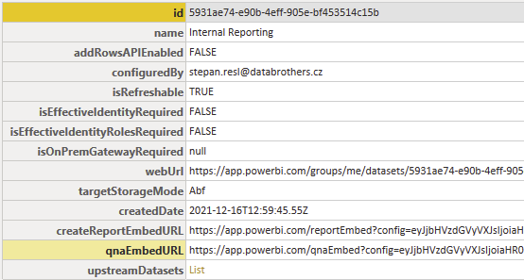
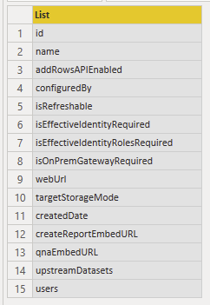
Get-Datasets

Slide 23
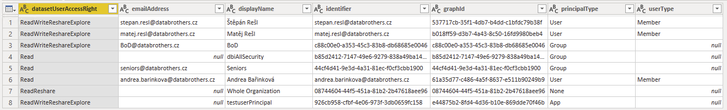
Get-DatasetUsers

Slide 24
POWER BI REST API
POST
DATASET USERS
TAKE OVER
UPDATE PARAMETERS
UPDATE DATASOURCES
REFRESH
BIND TO GATEWAY

Slide 25
POWER BI REST API
DELETE
CANCEL REFRESH
DELETE DATASET

Slide 26


BUT HOW TO ACCESS IT?
RESPONSES
USER
ACCESS TOKEN
SERVICE PRINCIPAL
RESPONSES

Slide 27
ACCESS TOKEN – WHY & HOW?

Slide 28

AUTHENTICATION
ACCESS TOKEN
AUTHORIZATION
REQUEST WITH ACCESS TOKEN
RESPONSE
IDENTITY

Slide 29
WHEN TO USE WHAT TYPE?
SERVICE PRINCIPAL
USER

Slide 30
USER
Such queries are executed from the user's perspective, so they only have access to artifacts that the user can see and always respect his rights.​
Get Reports
Get Page
Take over
Clone Report
Delete Report
Update Datasources
…

Slide 31
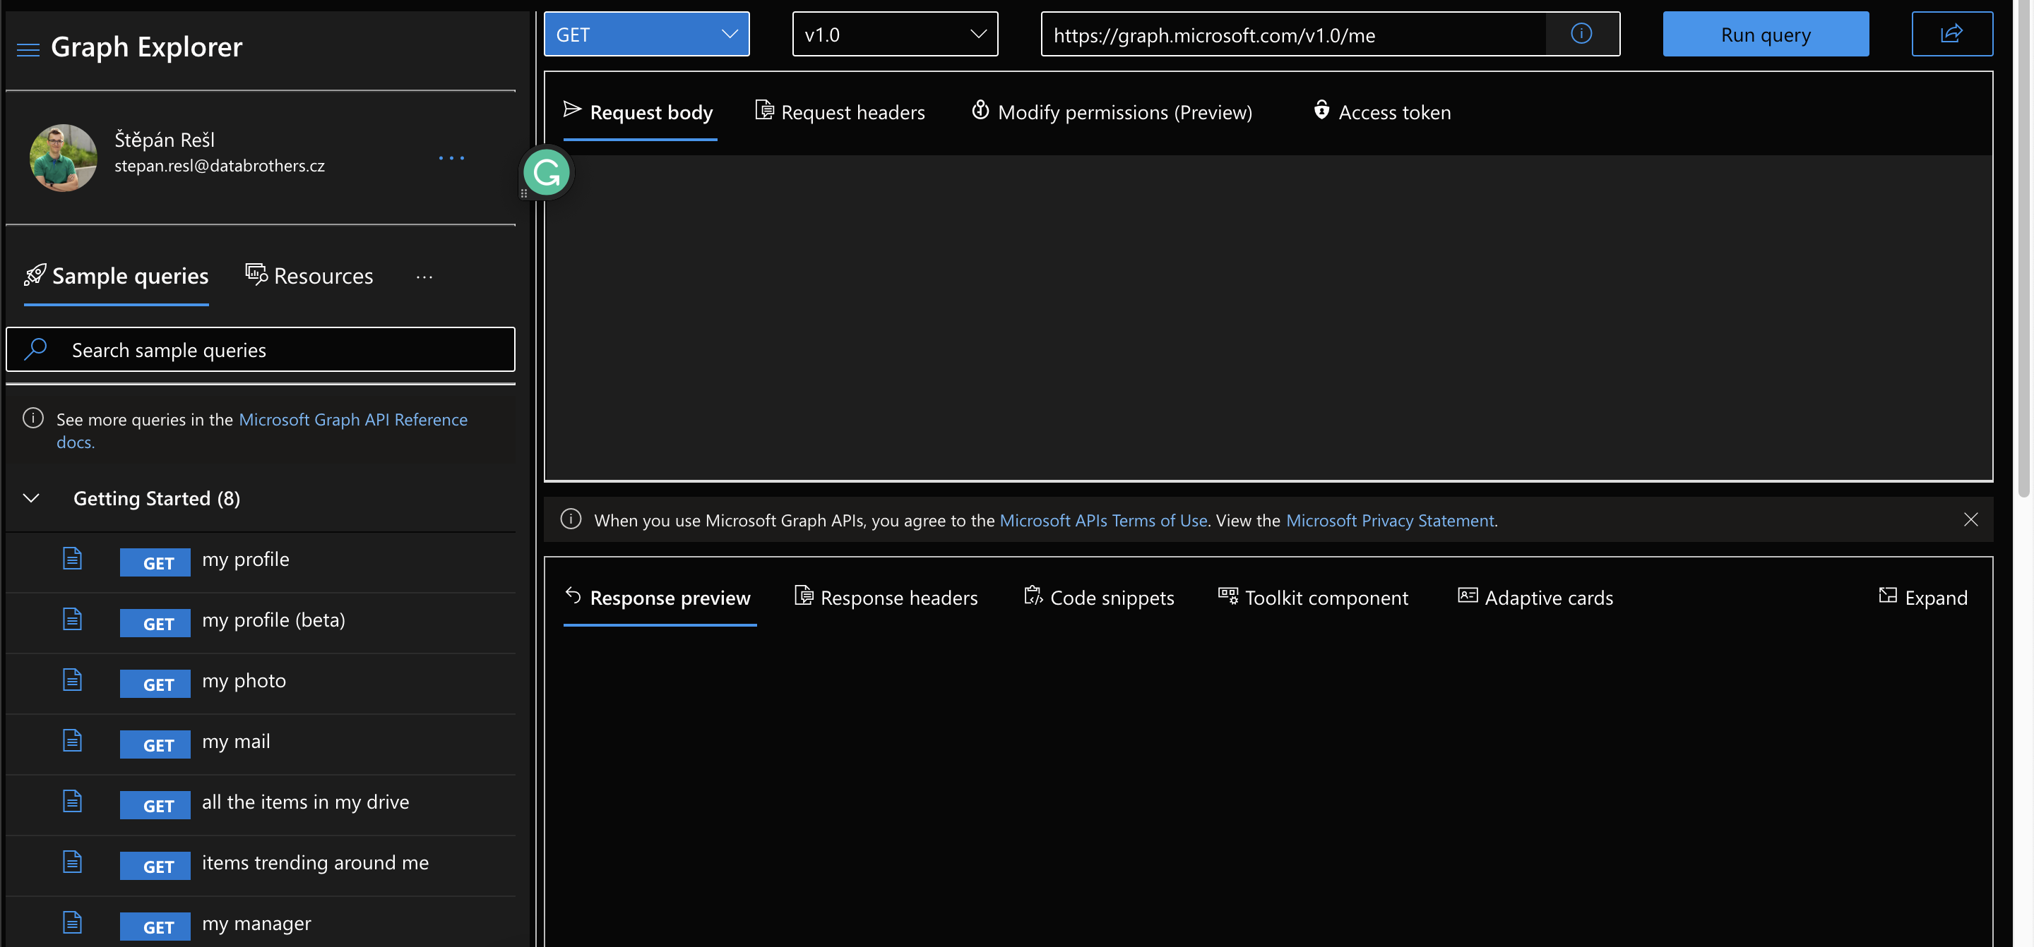
USER

Slide 32
USER

Slide 33
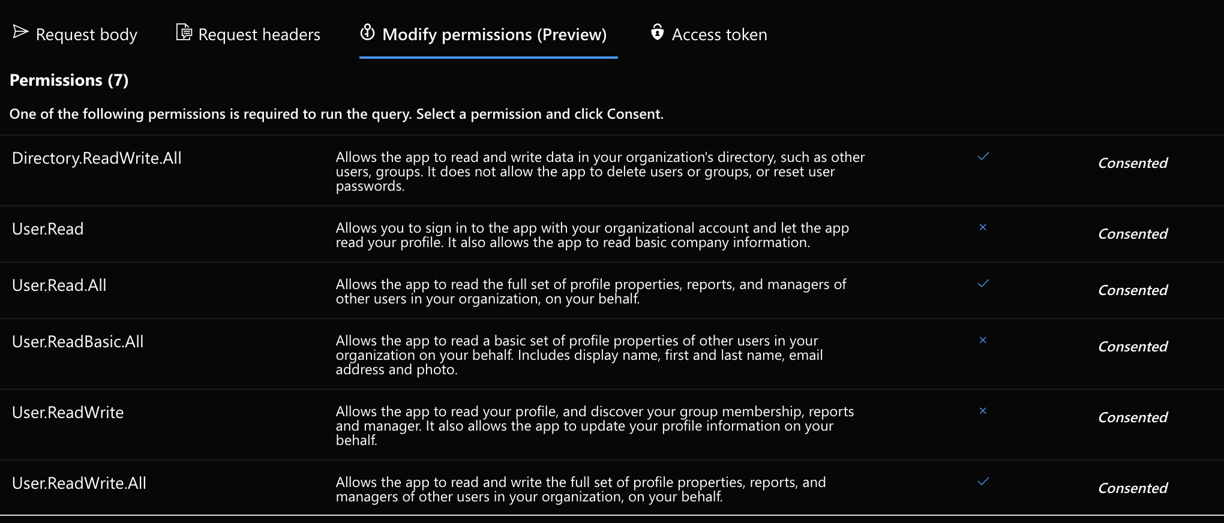
USER

Slide 34
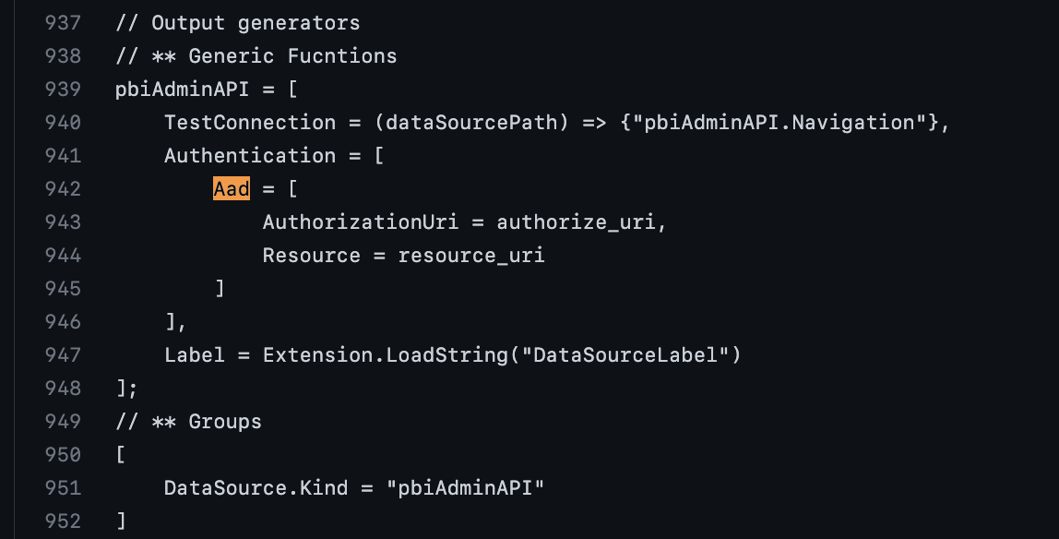
USER
EASY USER AUTHORIZATION AGAINST AAD IN POWER QUERY???
tirnovar/Power-BI-Admin-REST-API-Connector: Power BI REST API Connector - Admin Version (github.com)

Slide 35
SERVICE PRINCIPAL
Queries of this type are directly aimed at searching for information about the environment, its management and its modification, such as:
Get Groups
Get Datasources Of Dataset
Get Users of Dataset
Get ActivityEvents
Get WidelySharedArtifactsLinksSharedToWholeOrganization
Rotate EncryptionKey
Set Information Protection Label
…

Slide 36
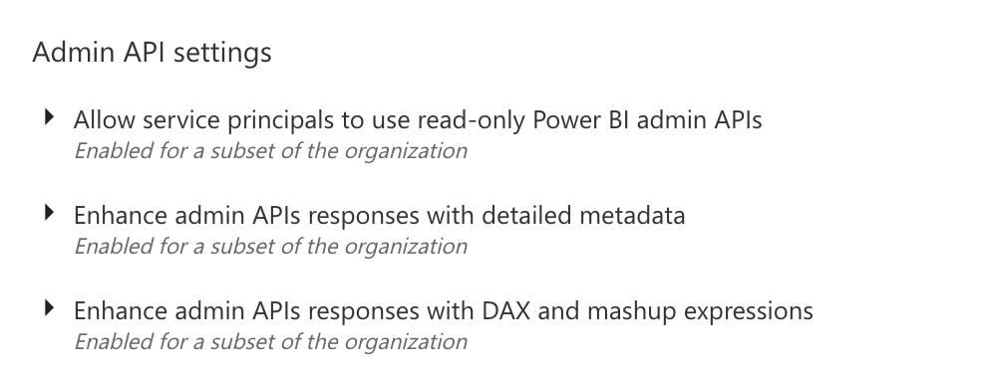
SERVICE PRINCIPAL NEEDS

Slide 37

Oauth with Power Query
M IS FOR MAGIC!!!

Slide 38
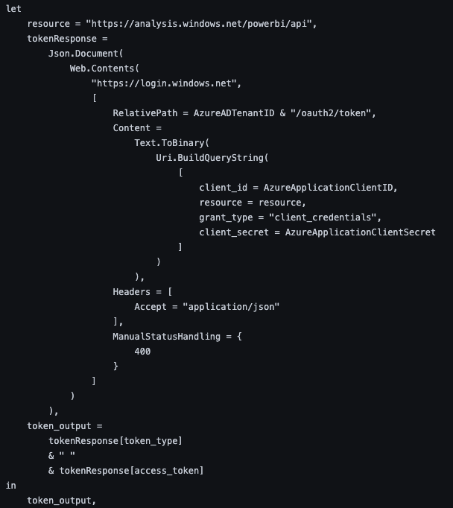
Oauth with Power Query
URL
RELATIVE PATH
BODY OF CALL
Power_BI_REST_API_PQ/get-BearerToken.pq at main · tirnovar/Power_BI_REST_API_PQ (github.com)

Slide 39
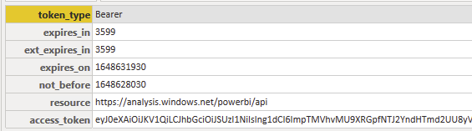
RESPONSE
!!!!!!!

Slide 40
Oauth with Power Query
URL
RELATIVE PATH
BODY OF CALL
ACCESS TOKEN BUILDER
Power_BI_REST_API_PQ/get-BearerToken.pq at main · tirnovar/Power_BI_REST_API_PQ (github.com)

Slide 41
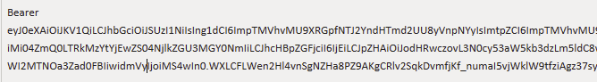
COMPLETED RESPONSE
TOKEN TYPE
ACCESS TOKEN

Slide 42
Oauth with Power Query
RESOURCE IS HERE
WHERE I CAN GET THESE???
Power_BI_REST_API_PQ/get-BearerToken.pq at main · tirnovar/Power_BI_REST_API_PQ (github.com)

Slide 43
IDS & SECRETS

Slide 44

IDs & Secrets

Slide 45
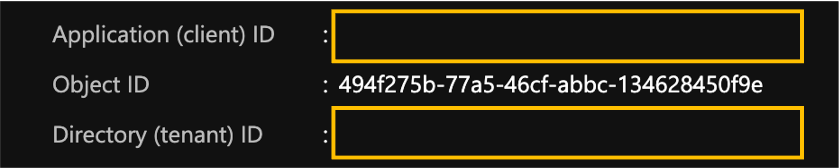

IDs & Secrets
https://portal.azure.com/#blade/Microsoft_AAD_IAM/ActiveDirectoryMenuBlade/RegisteredApps

Slide 46
IDs & Secrets

Slide 47
PRODUCTION TIME

Slide 48
RULES THAT HAS TO BE FOLLOWED
Every API Call has its limitations (calls per Hour, execution time, permissions,…)
Client secret & Generated Token has its own lifespan and after expiration you have to create a new one!
Power BI Desktop will allow you to do a little more then your dataset really can in Power BI Service. But Dataflow will save you!
Dataflows store entities/tables as a type table. If loaded query output is text, number etc... Dataflow natively converts it. To prevent it you have to disable the load of query.
Data Sources that use Anonymous authentication are automatically given the privacy level Public!!!

Slide 49
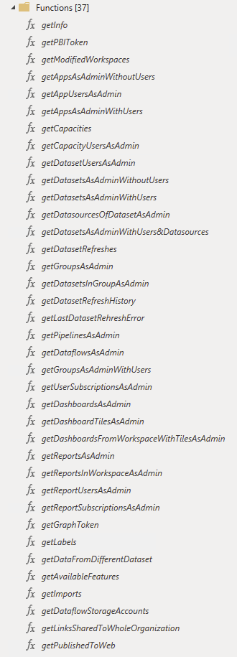
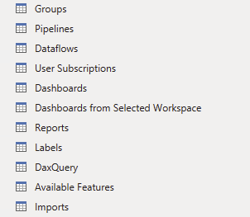
Lets build Dataset from functions
GitHub - tirnovar/Power_BI_REST_API_PQ

Slide 50

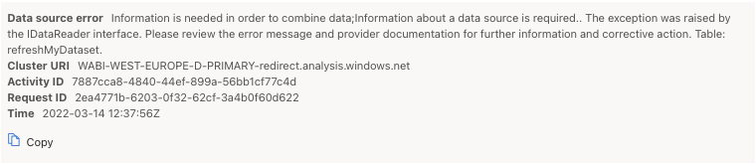
What Will will see on refresh in PBIS?

Slide 51
WHY?
?
Chris Webb's BI Blog: Power BI Data Privacy Levels And Cloud /Web-Based Data Sources Or Dataflows Chris Webb's BI Blog (crossjoin.co.uk)

Slide 52
How to make it work?
❌
✅

Slide 53
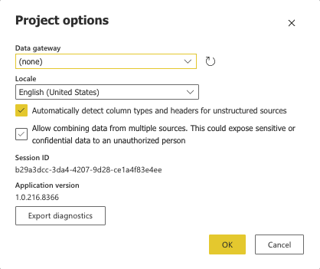
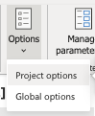
How to make it work?

Slide 54
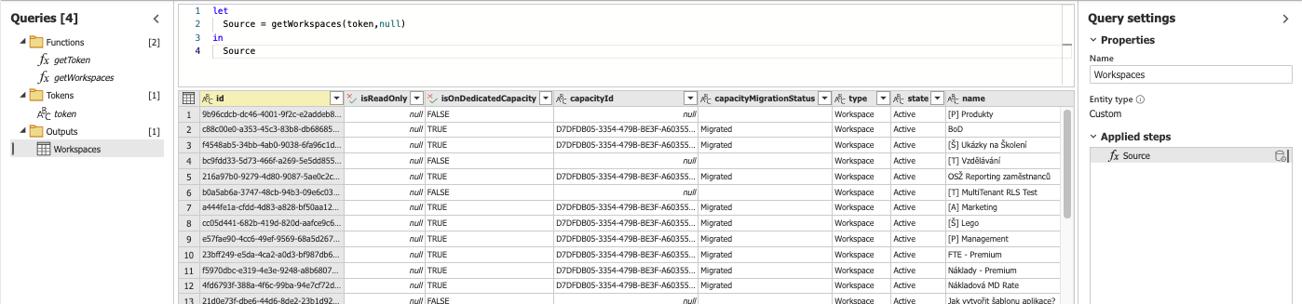
Data showtime

Slide 55

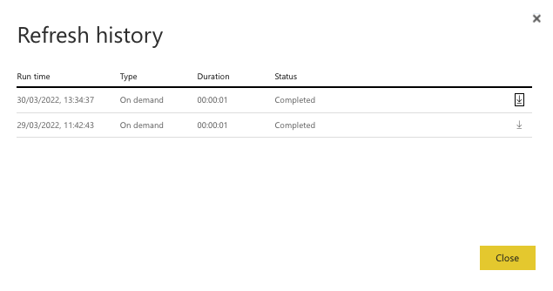
What about the refresh now?

Slide 56
New construction schema?
Queries with different refresh periods
POWER BI REST API DATA
DATASET
DATASET
GRAPH API DATA

Slide 57
THANK YOU FOR THE ATTENTION

Slide 58

WHERE TO FIND THIS PRESENTATION?

